Slide 1
Linear Algebra

Slide 2
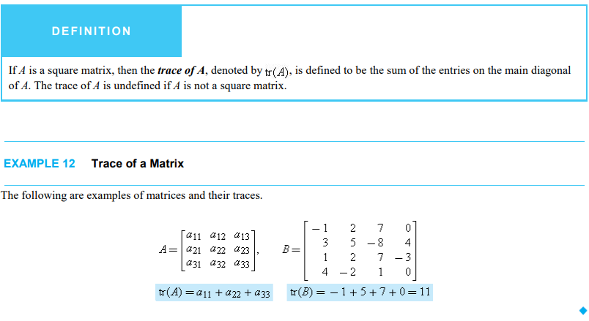

Slide 3
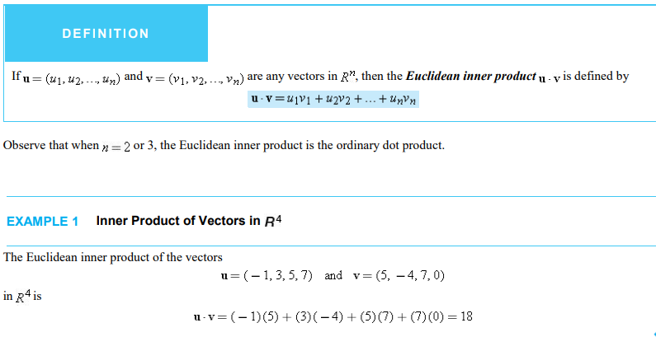
Notes:
Further practice questions are in notes

Slide 4
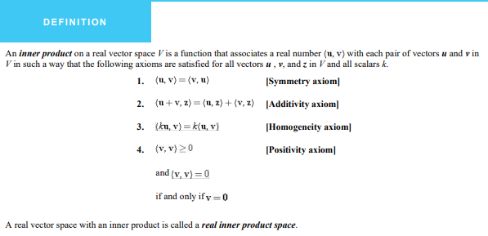

Slide 5
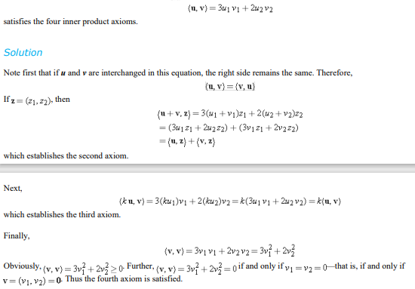
Replace value here
Put u=u1+v1
Put ku1 in u1 and V1
Put u1=v1 for same
Notes:
See in my notes of these solution

Slide 6
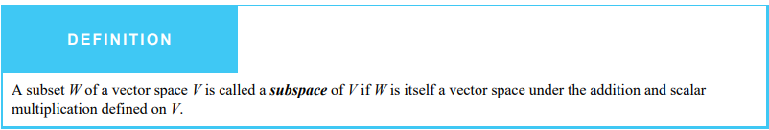
In general, one must verify the ten vector space axioms to show that a set W with addition and scalar multiplication forms a vector space.
Theorem:
If W is a set of one or more vectors in a vector space V,then W is a subspace of V if and only if following condition hold:
If u and v are vectors in w ,then u+v is in w.
If k is any scalar and u is any vector in w ,then ku is in w.
Notes:
Combine eq 1 and 2 w= ku+kv can use for satisfy : Numerical solution in my Notes(mannual)

Slide 7
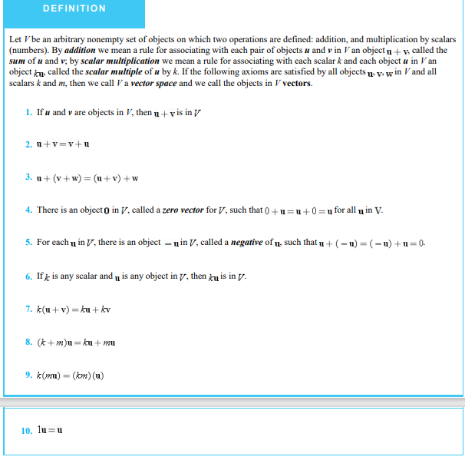

Slide 8
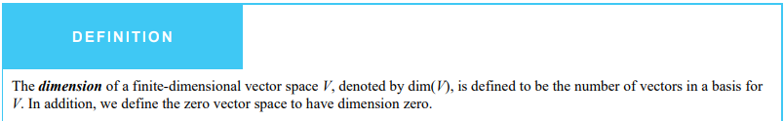
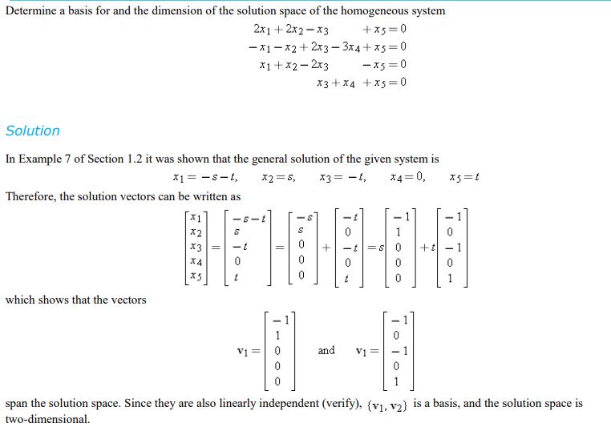
Notes:
Number of vector in basis set is called dimension

Slide 9
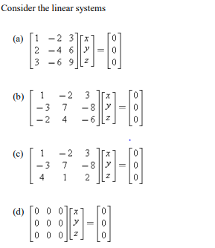
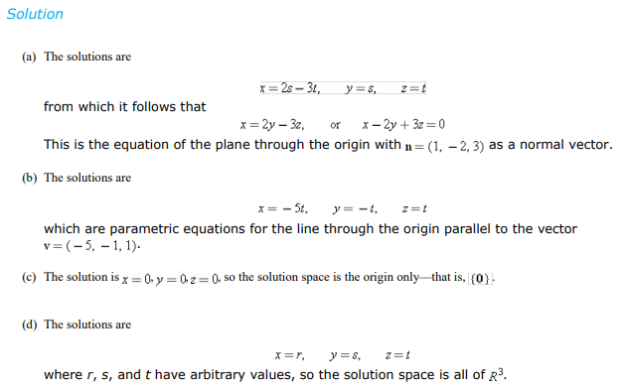
PRACTICE SUMS

Slide 10
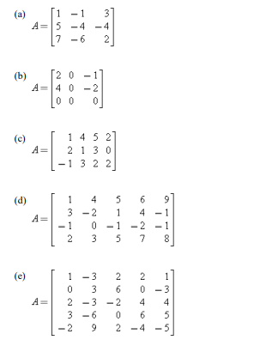

Slide 11
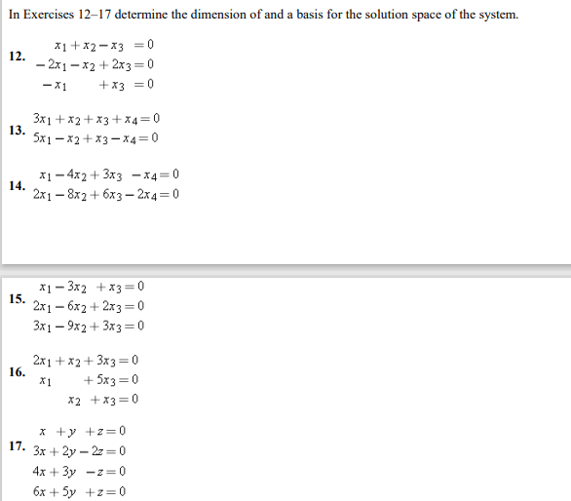
PRACTICE SUMS

